Slide 1
Sales dashboard
CAPSTONE PROJECT
Presented By:
Somanchi Sujan –Visakhapatnam-Computer Science

Slide 2
OUTLINE
Problem Statement
Proposed System/Solution
System Development Approach
Result
Conclusion
Future Scope
References

Slide 3
Problem Statement
This project provides a comprehensive guide for creating a sales dashboard to visualize the annual profits of product categories such as clothing, furniture, and electronics. The procedure includes steps for data collection, preparation, and integration, followed by dashboard design using business intelligence tools like Power BI. Key aspects covered include data cleaning, visualization creation, customization, and testing. This project emphasizes the importance of regular updates and maintenance to ensure the dashboard's accuracy and relevance. By following these guidelines, businesses can develop an effective tool for monitoring sales performance and supporting strategic decision-making.

Slide 4
Proposed Solution
CHAPTER 1:
Introduction to Data Analytics
Data analytics is the process of examining data sets to draw conclusions about the information they contain. This process involves the application of statistical analysis, algorithms, and other data processing techniques to uncover patterns, correlations, trends, and insights that can inform decision-making. Data analytics is a critical component of modern business strategy, enabling organizations to make data-driven decisions that enhance operational efficiency, drive innovation, and improve customer experiences.
Tools Used in Data Analytics
Several tools are commonly used in data analytics to facilitate the analysis, visualization, and interpretation of data. These tools range from simple spreadsheet applications to advanced software platforms and programming languages. Here are some of the key tools:
Microsoft Excel: Widely used for its accessibility and ease of use, Excel offers basic data analysis functions, including pivot tables, charts, and simple statistical functions.

Slide 5
Proposed Solution
SQL (Structured Query Language): SQL is essential for querying and managing data in relational databases. It allows users to extract, manipulate, and analyze large datasets efficiently.
Tableau: A leading data visualization tool that helps in creating interactive and shareable dashboards. Tableau allows users to connect to various data sources, perform analytics, and visualize data in a user-friendly interface.
Power BI: Developed by Microsoft, Power BI is a business analytics tool that provides interactive visualizations and business intelligence capabilities with an interface simple enough for end users to create their own reports and dashboards.
SAS (Statistical Analysis System): A software suite developed by SAS Institute for advanced analytics, multivariate analysis, business intelligence, and data management. SAS is known for its robust data handling capabilities and extensive statistical procedures.

Slide 6
Proposed Solution
CHAPTER 2:
Introduction to Power BI
Power BI is a powerful business analytic tool developed by Microsoft that enables users to visualize data and share insights across their organization. It connects to a wide range of data sources, simplifies data preparation, and drives ad-hoc analysis. With interactive dashboards and rich visualizations, Power BI provides a comprehensive view of key business metrics in real-time.
Power BI Tools for Building a Sales Analysis Dashboard : To build a comprehensive sales analysis dashboard for a company dealing in clothing, electronics, and furniture, we will leverage several key features and tools within Power BI
1. Data Connection and Integration

Slide 7
Proposed Solution
Power BI allows users to connect to various data sources, such as Excel spreadsheets, SQL databases, cloud services (like Azure), and online services (such as Google Analytics or Salesforce). For our sales dashboard, we would import sales data, client information, and budget details from these sources to create a unified data set.
2. Data Transformation with Power Query
Merging and Appending Data: Combine multiple tables and files into a single data model.
Filtering and Cleaning Data: Remove unnecessary columns, filter rows, and handle missing values.
Data Shaping: Apply transformations such as pivoting and unpivoting columns to reshape data as needed.
3. Data Modeling
Defining Relationships: Establish relationships between tables (e.g., linking sales data with product information and client demographics).

Slide 8
Proposed Solution
Calculated Columns and Measures: Create calculated columns and measures using DAX (Data Analysis Expressions) to derive new insights, such as total sales, average sales per client, and year-over-year growth.
4. Visualization Tools
Charts and Graphs: Utilize bar charts, line charts, pie charts, and area charts to visualize sales trends over time, distribution across products, and sales performance by region or salesperson.
Tables and Matrices: Display detailed sales figures and comparisons in an organized tabular format.
Slicers and Filters: Implement slicers and filters to allow users to dynamically interact with the dashboard by filtering data based on categories such as product type (clothing, electronics, furniture), sales region, or time period.
Maps: Use geographic data to create map visualizations that show sales distribution across different locations.
5. Interactive Dashboards

Slide 9
Proposed Solution
Drill-Down and Drill-Through: Enable drill-down and drill-through features to allow users to explore data at various levels of detail, from high-level summaries to detailed transactions.
Real-Time Data: Set up real-time data streaming to update dashboards with live data feeds, ensuring that the sales team has the latest information at their fingertips.
Custom Visuals: Incorporate custom visuals from the Power BI marketplace to enhance the dashboard’s functionality and appearance.
6. Performance Comparison
To evaluate sales performance against budgeted targets:
KPI Visuals: Use Key Performance Indicator (KPI) visuals to compare actual sales with budgeted targets, displaying variances and performance trends.
Conditional Formatting: Apply conditional formatting to highlight key insights, such as under performing products or regions.

Slide 10
Proposed Solution
CHAPTER 3: “PROCEDURE”
Open Power BI Desktop.
Import Data:
Click on 'Get Data' and select your data source (Excel, SQL Server, etc.).
Clean and Transform Data:
Use Power Query Editor to clean and transform the data.
Create Visualizations:
Use the 'Visualizations' pane to add charts:
Bar Chart: Add a bar chart for profit by product category

Slide 11
Proposed Solution
Line Chart: Add a line chart for monthly profit trends.
Add Filters:
Use visuals to add filters for product category and date.
Format the Dashboard:
Customize colors, fonts, and layout for clarity.
Publish:
Publish the dashboard to Power BI Service

Slide 12
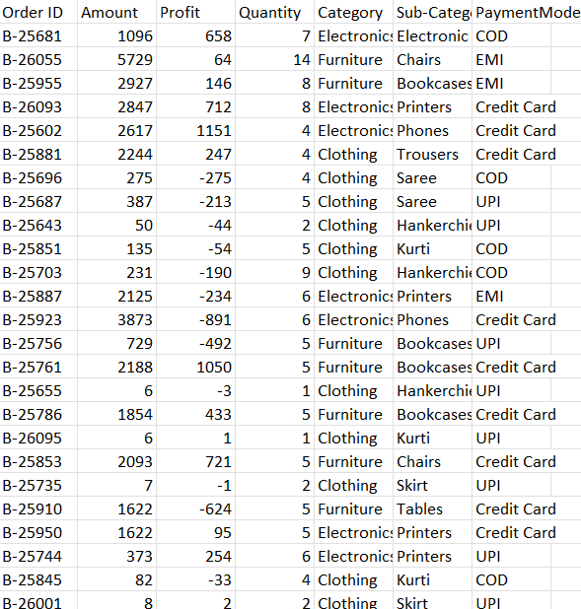
System Approach

Slide 13
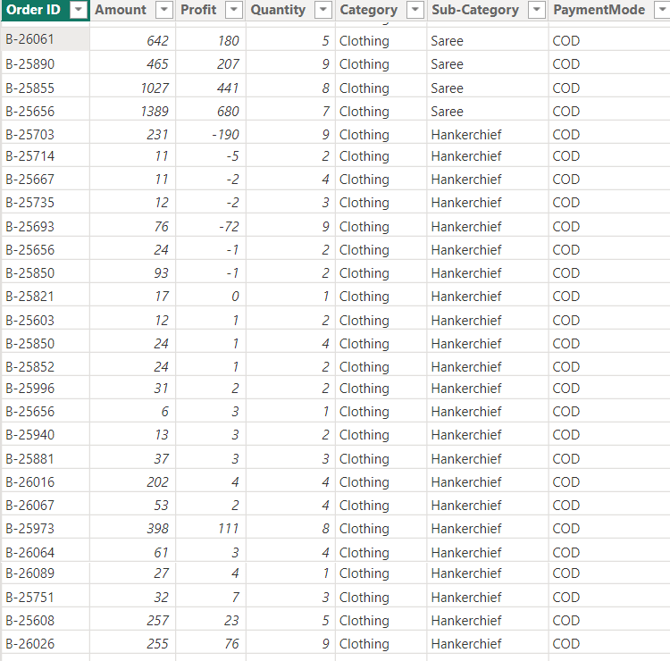
System Approach
AFTER CLEANING THE DATA

Slide 14
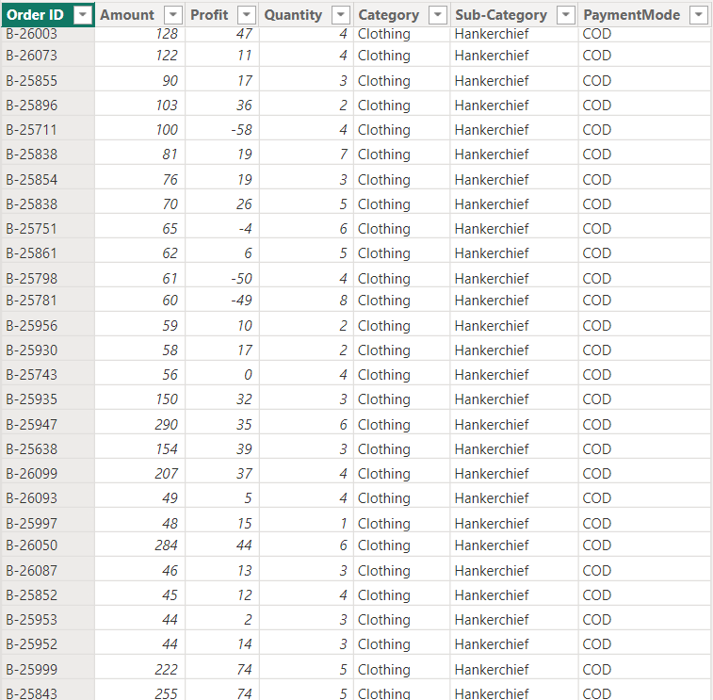
System Approach

Slide 15
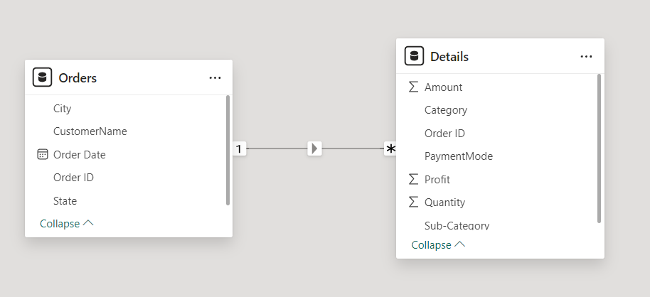
System Approach
Model view:

Slide 16
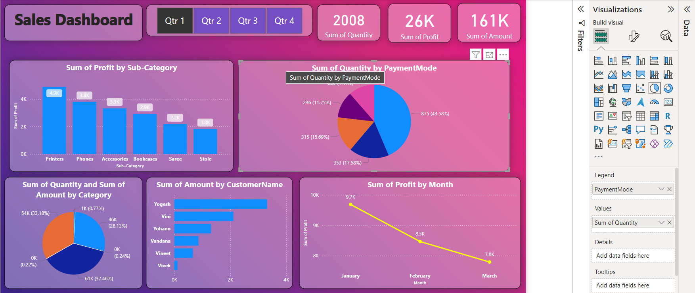
Result
DASHBOARD:

Slide 17
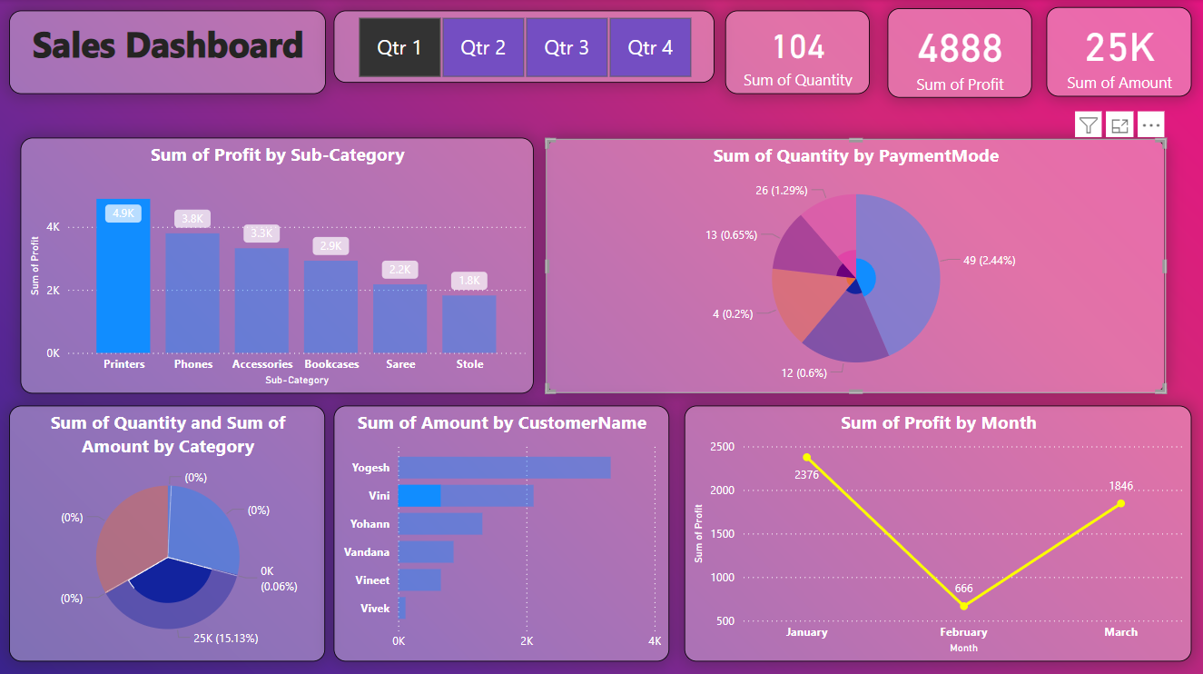
Result
PROFIT BY SUB CATEGORY:

Slide 18
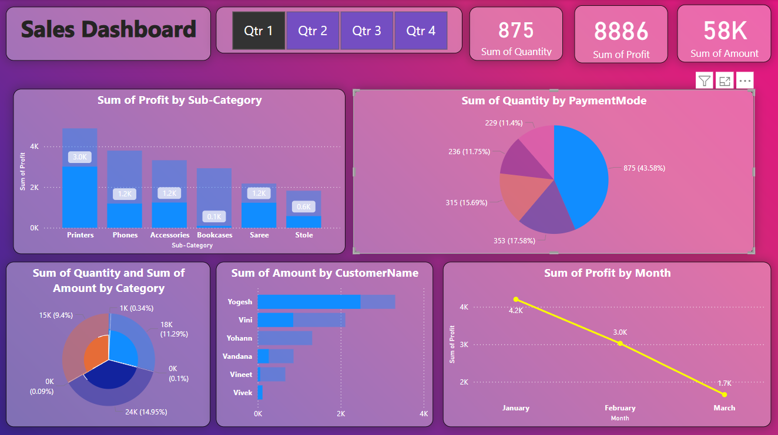
Result
BY PAYMENT MODE:

Slide 19
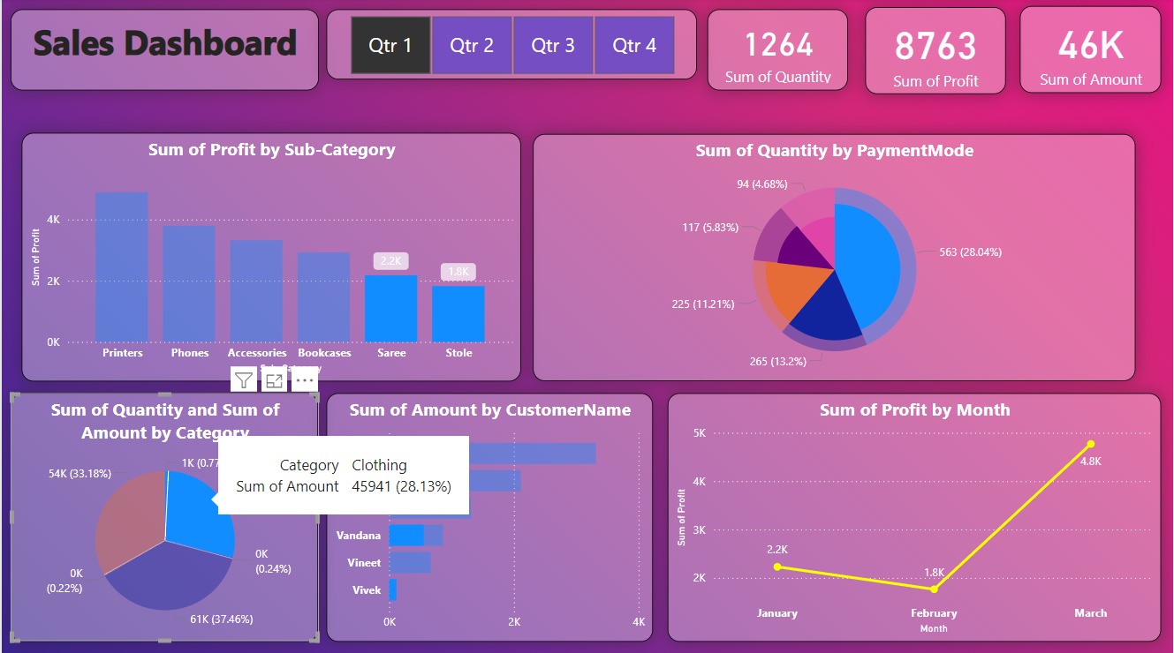
Result
SUM OF QUATITY AND SUM OF AMOUNT BY CATEGORY:

Slide 20
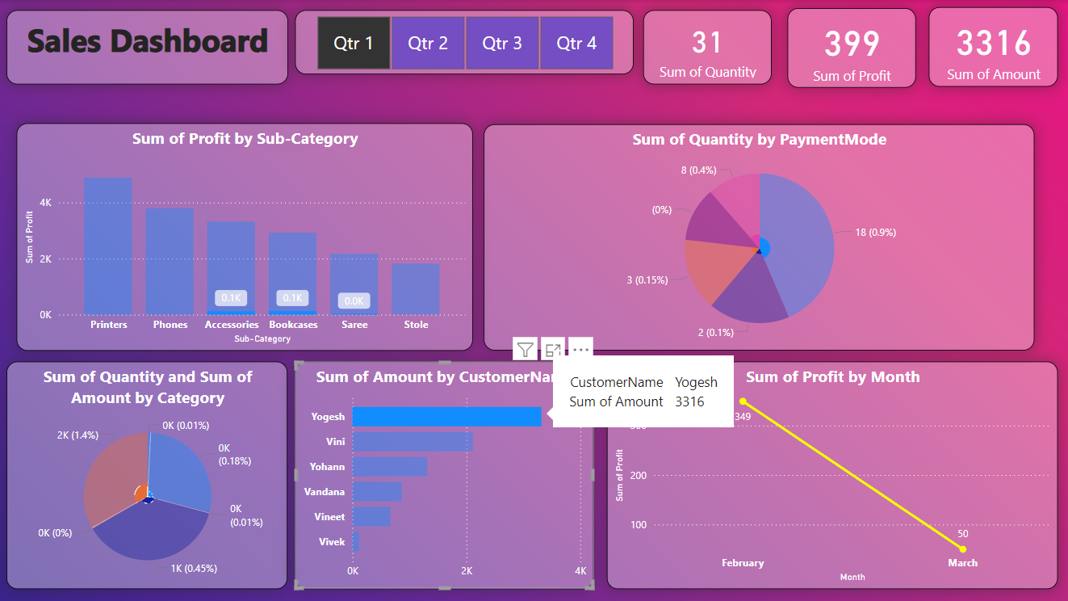
Result
SUM OF AMOUNT BY CUSTOMER NAME:

Slide 21
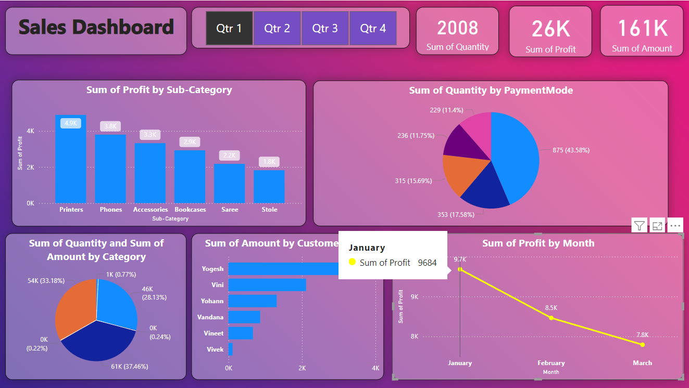
Result
SUM OF PROJECT BY MONTH:

Slide 22
Conclusion
Creating a sales dashboard for visualizing profits of product categories like clothing, furniture, and electronics over a year involves collecting and cleaning data, choosing a BI tool, and designing the dashboard. This process ensures stakeholders can easily monitor profit trends and make data-driven decisions.
Regular maintenance and updates keep the dashboard relevant and accurate, allowing for continuous improvement based on user feedback. A well-designed sales dashboard is a valuable asset, providing clear insights that support strategic planning and drive business growth.

Slide 23
Future scope
DEVELOP PREDECTIVE ANALYTICS TO FORECASTE SALES TRENDS:
- Leverage machine learning algorithms and historical data to predict future sales performance,
- Enable businesses to proactively adjust strategies, optimize resources, and drive growth,
- Enhance the dashboard's capabilities to provide actionable insights and stay ahead in the competitive market.

Slide 24
References
1. Power BI tools - https://www.youtube.com/watch?v=zSgmrWQa03s
2. Dashboard building and data analysis -
https://www.youtube.com/watch?v=wy6wEHIfJyg&list=PLMfXakCUhXsEUtk8c0zWr4whamGxLhAu0&index=5
3. Tableau tools - https://www.youtube.com/watch?v=NLCzpPRCc7U

Slide 25

course certificate 1

Slide 26

course certificate 2

Slide 27
THANK YOU

